Slide 1
styles of writing
There are many different categories of writing. These different styles of writing each have their own characteristics.
Creative Writing – novels, short stories, poetry
Journalistic Writing – newspapers, magazines
Persuasive Writing – advertising, media campaigns
Scientific Writing – use of scientific vocabulary
(technical terms)

Slide 2
Cont’d …
LEGAL WRITING – legal documents
BUSINESS WRITING – annual reports etc.
There is one more category that is important to us. Can you guess what that is?
Let’s find out!!

Slide 3

ACADEMIC WRITING
Let’s start with a preview activity
Answer the 4 questions on your worksheet in brief.
Now let’s discuss the answers.
Then let’s watch a video.
Answer the 3 questions on your worksheet,
based on the video

Slide 4
Video
https://www.youtube.com/watch?v=mZQgd2sPxpk&t=99s
12 common errors in academic English and how to fix them.

Slide 5
ACADEMIC WRITING
WHAT IS ACADEMIC WRITING?
Broad definition:
any writing done to fulfill a requirement of a college or university.
Publications read by academics and researchers or presented at conferences.
Any writing given in an academic setting.

Slide 6
What documents will have academic writing?
Conference papers
Research papers or articles
Books and book reports
Translations
Academic journals
Abstracts
Explications
Essays
Dissertations & Thesis

Slide 7
What are the characteristics of academic writing?
Planning: to be analytical and organized.
Outline: A must. Will help formulate thoughts, make you aware of certain relationships between topics. Will help you to determine the appropriate information to be included in your paper.
Tone: Formal. DO NOT USE slang words, jargon, short forms, (abbreviations) or clichés.

Slide 8
Cont’d …
Language: must be clear and chosen for their accuracy.
(clarity)
Point–of–view: 3rd person. focus is to educate on facts.
Approach: Deductive reasoning as readers need to follow how you arrived at your conclusion and an Analytical approach.
IMPORTANT: Check with your institution the preferred format and style. – (IIT)

Slide 9
Cont’d …
STRUCTURE
3 distinct sections – IBC
Introduction: grab reader’s attention, identify the thesis of the paper.
To do this start with:
Several questions
A quote
Interesting facts or information
A definition of an important term related to the work.

Slide 10
Cont’d …
BODY: Main part of the work
Paragraphs should be clearly written, arranged in a logical order.
Chronological or order of importance. Paragraphs must be linked, and smooth flow maintained.
Within paragraphs: sentences must flow and refer back to topic. Cohesion is achieved by repeating important words, using synonyms and using transitional words.

Slide 11
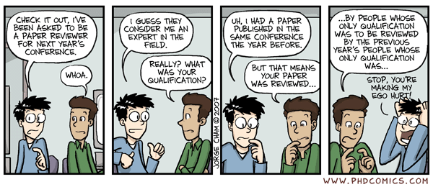
Cont’d …
CONCLUSION:
* re-emphasize the thesis * summarize the main points
* one para which shows the final conclusion * no new information

Slide 12
Useful links
Source: YouTube
(you must watch these videos again, although we watched it during the lecture, as they are very useful and easy to understand)
https://www.youtube.com/watch?v=mzqgd2spxpk
https://www.youtube.com/watch?v=f2sk0uk2cbg
https://www.youtube.com/watch?v=kbp0p8wxtcg

Slide 13
Vocabulary
Thesis: A long essay or dissertation involving personal research, written by a candidate for a university degree.
e.g. "a doctoral thesis“
JARGON: special words or expressions used by a profession or group that are difficult for others to understand.
e.g. "legal jargon“
CLICHÉ: refers to an expression that has been overused to the extent that it loses its original meaning or novelty. a cliché may also refer to actions and events that are predictable because of some previous events. all examples of cliché are expressions that were once new and fresh.

